Slide 1
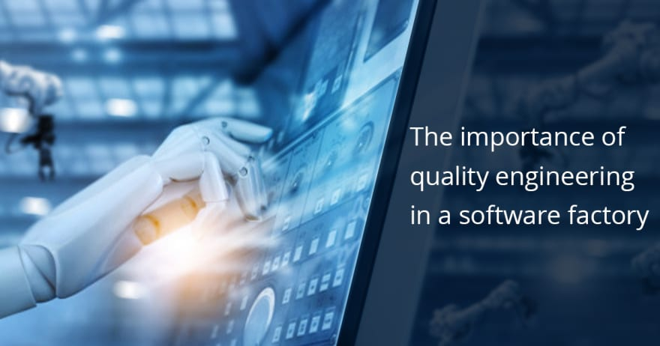
Software QUALITY ENGINERING
SOFTWARE INSPECTION, SOFTWARE REVIEWS, INSPECTION CHECKS AND METRICS

Slide 2
Agenda
SOFTWARE INSPECTION
SOFTWARE REVIEWS
INSPECTION CHECKS
METRICS

Slide 3
SOFTWARE INSPECTION
Software inspection, also known as software review, is a process of evaluating the quality of software artifacts such as source code, requirements, design documents, and test cases. It is a formalized and structured process of examining software documents for defects and other issues to improve the overall quality of the software.
During software inspection, a group of people, often including developers, testers, and other stakeholders, examine the software documents systematically and critically. The goal is to identify defects such as coding errors, design flaws, and missing requirements that may lead to problems in the software's functionality, performance, security, and maintainability.

Slide 4
SOFTWARE INSPECTION Techniques
Software inspection can be performed using various techniques such as walkthroughs, peer reviews, and formal inspections. The process involves a set of defined steps and criteria for evaluating the software documents, documenting the findings, and reporting them to the relevant stakeholders for corrective action.

Slide 5
SOFTWARE INSPECTIOn benefits
The benefits of software inspection include improved software quality, reduced costs and time in software development, increased productivity, and better communication among team members. By detecting and addressing defects early in the development process, software inspection helps to prevent more costly and time-consuming problems later on.

Slide 6
SOFTWARE INSPECTIOn Example
Let's say a software development team is working on developing a new web application for an online store. As part of the development process, the team conducts a software inspection of the application's source code.
The software inspection team would typically include developers who did not write the code being inspected, testers, and possibly other stakeholders such as project managers or business analysts. The team would review the code line by line, looking for defects, errors, or potential issues that could affect the application's quality or performance.
Some examples of issues that could be identified during the software inspection include:
Code that is difficult to read or understand
Code that is not well-documented or lacks comments
Incorrect or inconsistent use of variables or data types
Potential security vulnerabilities or data privacy concerns
Logic errors that could cause the application to malfunction or crash
Poor performance or scalability due to inefficient code

Slide 7
SOFTWARE INSPECTIOn Example
After identifying these issues, the software inspection team would document their findings and report them back to the development team for corrective action. The development team would then address the issues and make any necessary changes to the code before moving on to the next phase of the development process
By conducting software inspections, the development team can improve the quality of their code, catch errors early, and ultimately deliver a more reliable and efficient application.

Slide 8
What are SOFTWARE REVIEWS ?
Software review is a process of examining software artifacts, such as requirements, design documents, code, and test plans, to detect and correct errors or defects that could impact the quality, reliability, and performance of the software. Software reviews are a key part of the software development process and are performed at different stages of the development lifecycle.

Slide 9
Types of software reviews
There are several types of software reviews, including:
Peer reviews: These are informal reviews in which team members examine each other's work and provide feedback. Peer reviews are usually conducted during the development process and can be very effective in catching errors early.
Walkthroughs: Walkthroughs are a type of peer review that involves a guided tour of the software artifact, where team members discuss the code, design, or requirements and identify any issues.
Technical reviews: Technical reviews are more formal than peer reviews and are typically conducted by a team of experts in the field, such as senior developers, architects, or system engineers.
Inspections: Inspections are the most formal type of software review and involve a team of reviewers who examine the software artifact in detail, using checklists and other quality criteria to identify defects.

Slide 10
benefits of software reviews
The benefits of software reviews include improved quality, increased productivity, and reduced development costs. By detecting and addressing defects early in the development process, software reviews can help prevent more costly and time-consuming problems later on. They also provide an opportunity for team members to learn from each other, share knowledge, and improve their skills.

Slide 11
Example of software reviews
Let's say a software development team is working on a new mobile application. As part of the development process, the team conducts a code review to examine the quality of the code.
The code review team would typically include senior developers, architects, or system engineers who have expertise in the programming language or technology used for the mobile application. The team would review the code line by line, looking for defects, errors, or potential issues that could impact the quality or performance of the application.
Some examples of issues that could be identified during the code review include:

Slide 12
Example of software reviews
Incorrect use of variables or data types
Poorly written or inefficient code
Inconsistent or unclear naming conventions
Potential security vulnerabilities or data privacy concerns
Logical errors that could cause the application to malfunction or crash
After identifying these issues, the code review team would document their findings and report them back to the development team for corrective action. The development team would then address the issues and make any necessary changes to the code before moving on to the next phase of the development process.

Slide 13
Example of software reviews
By conducting code reviews, the development team can improve the quality of their code, catch errors early, and ultimately deliver a more reliable and efficient application. They also provide an opportunity for team members to learn from each other, share knowledge, and improve their skills.

Slide 14
Identifying Resources and Defining Roles and Responsibilities
In the planning phase, resources required for SQA activities are identified, and roles and responsibilities are defined for each team member. This includes identifying the personnel who will be involved in SQA activities, such as SQA engineers, testers, and project managers. The roles and responsibilities of each team member are defined to ensure that everyone understands their role in the SQA process.

Slide 15
What is INSPECTION CHECKS?
Inspection checks are a systematic process of examining software artifacts, such as requirements, design documents, or source code, to detect and correct defects or errors. The goal of inspection checks is to improve the quality, reliability, and maintainability of the software by identifying and addressing issues early in the development process.
During inspection checks, a team of reviewers examines the software artifact in detail, using predefined checklists, quality criteria, or standards to identify potential issues. The reviewers are typically experts in the software domain and have specialized knowledge of the technology, programming language, or software development process.

Slide 16
process of inspection checks
The process of inspection checks typically involves the following steps:
Planning: Defining the scope of the inspection, selecting the reviewers, and preparing the inspection checklist or quality criteria.
Preparation: Reviewing the software artifact and identifying potential issues or defects.
Inspection: Conducting a formal review of the software artifact, using the inspection checklist or quality criteria to guide the review process.
Rework: Addressing any issues or defects identified during the inspection, either by correcting the software artifact or modifying the inspection checklist.
Follow-up: Verifying that the issues or defects have been addressed and monitoring the effectiveness of the inspection process

Slide 17
Benefits of inspection checks
The benefits of inspection checks include improved software quality, reduced development costs and time, increased productivity, and better communication among team members. By detecting and addressing defects early in the development process, inspection checks can help prevent more costly and time-consuming problems later on. They also provide an opportunity for team members to learn from each other, share knowledge, and improve their skills.

Slide 18
Example of inspection checks
Let's say a software development team is working on a new web application. As part of the development process, the team conducts an inspection check of the application's user interface design.
The inspection check team would typically include experts in user interface design, such as usability experts or graphic designers. The team would review the design in detail, using predefined checklists or quality criteria to identify potential issues, such as poor layout, confusing navigation, or inconsistent branding.

Slide 19
Example of inspection checks
By conducting inspection checks, the development team can improve the quality of their design, catch issues early, and ultimately deliver a more user-friendly and aesthetically pleasing application. They also provide an opportunity for team members to learn from each other, share knowledge, and improve their skills

Slide 20
Example of inspection checks
This involves reviewing and analyzing the software requirements to ensure that they are complete, accurate, and meet the needs of the end-users. The SQA team will review the requirements document and verify that all the required features and functionalities are included. They will also check if the requirements are clearly defined, concise, and free of any ambiguity.
For example, suppose a company is developing a new payroll system. During the requirements review stage, the SQA team will review the requirements document to ensure that all the required features, such as employee information management, time tracking, and tax calculations, are included. They will also verify that the requirements are clear and unambiguous, for instance, by ensuring that the definition of employee status (e.g., full-time, part-time, or contract) is clearly stated and consistently used throughout the requirements document.

Slide 21
What is METRICS?
In software development, metrics are quantitative measures used to track and evaluate various aspects of the software development process. Metrics can be used to assess the quality of the software, the efficiency of the development team, and the overall progress of the project.
Metrics can be collected and analyzed at various stages of the software development process, including requirements gathering, design, coding, testing, and deployment. Some common metrics used in software development include:

Slide 22
What is METRICS?
Defect density: The number of defects or issues found in the software per unit of code or functionality.
Code complexity: A measure of the complexity of the code, usually based on factors such as the number of lines of code, the number of branches in the code, or the number of variables used.
Code coverage: A measure of the proportion of the code that is covered by automated tests.
Time to market: The time it takes to deliver a new software product or feature to market, from initial concept to final release.
Customer satisfaction: A measure of how satisfied customers are with the software, usually based on surveys or feedback.
Productivity: A measure of how efficiently the development team is working, usually based on factors such as the number of features delivered per unit of time, or the number of defects fixed per unit of time.

Slide 23
What is METRICS?
By tracking and analyzing these metrics, software development teams can identify areas for improvement, make data-driven decisions, and optimize their development process for better quality and efficiency.

Slide 24
Benefits of metrics
There are several benefits of using metrics in software development:
Improved quality: Metrics can help identify areas of the software that are prone to defects or issues, allowing the development team to focus on improving quality and reducing the number of defects.
Better decision-making: Metrics provide objective, data-driven insights that can help inform decision-making about the development process, such as which features to prioritize, which areas to focus on for improvement, and when to release the software.
Increased productivity: Metrics can help identify bottlenecks in the development process, such as areas where developers are spending too much time, allowing the team to optimize their processes and increase productivity.

Slide 25
Benefits of metrics
Improved communication: Metrics provide a common language and framework for discussing and understanding the software development process, helping team members to communicate more effectively and collaborate better.
Increased customer satisfaction: By measuring customer satisfaction with the software, the development team can identify areas for improvement and make changes that better meet the needs and expectations of the end-users.
Early identification of issues: By monitoring metrics throughout the development process, the development team can identify issues early and take corrective action before they become more serious and costly to fix.

Slide 26
Benefits of metrics
Overall, metrics provide a valuable tool for software development teams to improve quality, increase productivity, and make data-driven decisions that ultimately lead to better software products and greater customer satisfaction.

Slide 27
Example of matrics
Let's say a software development team is working on a new mobile application. As part of their development process, they track several metrics, including:
Defect density: The number of defects or issues found in the software per unit of code or functionality.
User engagement: A measure of how often users are using the application and how long they are spending on it.
Crash rate: A measure of how often the application crashes or freezes.
Time to market: The time it takes to deliver a new software product or feature to market, from initial concept to final release.

Slide 28
Example of matrics
If the defect density is high, the team can focus on improving the quality of the code, perhaps by implementing more rigorous testing procedures or reviewing code more carefully before it is merged.
If the user engagement is low, the team can focus on improving the user experience, perhaps by simplifying the interface or adding new features that users have requested.

Slide 29
Example of matrics
If the crash rate is high, the team can focus on improving the stability of the application, perhaps by conducting more thorough testing or fixing bugs more quickly.
If the time to market is long, the team can focus on streamlining their development process, perhaps by using more automated testing tools or adopting a more agile approach to development.
By using metrics in this way, the development team can continuously improve the quality and efficiency of their development process, leading to a better software product and greater customer satisfaction.

Slide 30

END OF LECTURE
Any Questions !!!

